Slide 1
Data Quality Control
Suzanne M. Leal
Baylor College of Medicine
sleal@bcm.edu
Copyrighted © S.M. Leal 2015

Slide 2
DNA Collection
Blood samples
  For unlimited supply of DNA
    Transformed cell lines
Buccal Swabs
    Small amounts of DNA
    DNA not stable
Saliva (Origene collection kit)

Slide 3
Whole Genome Amplification
Allows for the creation of large amounts of DNA from initial small DNA sample
Relatively inexpensive
  Compared to making transformed lines
Perform WGA on each sample three or more times
  Use pooled sample

Slide 4
Whole Genome Amplification
Can experience lower call rates and higher genotyping error rates
  Platform dependent
  Not recommended for Illumina Infinium products
    Performs better using Golden Gate Chemistry
Not recommend to use WGA samples for Copy Number Variant analysis

Slide 5
Measure DNA concentrations
Nanodrop
Picogreen

Slide 6
Genotype SNPs (~20-96) before Embarking on Large Scale Genotyping Project
Pros
  Genotype markers which can be used as DNA fingerprint
  Allows for Assessment of DNA quality
  For family data
    Access familial relationships

Slide 7
Genotype SNPs (~20-96) Before Embarking on Large Scale Genotyping Project
Cons
  May not be cost effective if DNA is generally believed to be good quality
  No family data
    Not necessary for checking relationships
  May be more cost effective to genotype array
    e.g. Human1M
  Remove samples which “fail”
    Those samples which do not meet quality control criteria

Slide 8
Detecting Genotyping Errors
Duplicate samples genotyped
  Study samples
  HAPMAP (e.g. CEU samples)
    Can compare genotypes to those in HapMap
Can use inconsistent duplicate samples to adjust clusters to improve allele calls
Will not detect systematic errors

Slide 9
Effects of Genotyping Error
If there is no bias in genotyping error between cases and controls
  Same rates of genotyping errors in case and control data
For family based association studies - Trios
  Can increase both type I and II error
Population based studies
  Increases type II error only

Slide 10
Effects of Genotyping Errors
If cases and controls are genotyped
  At different times
  Different institutions
Or one group, case or control, is predominately genotyped at one time/same batch
Can lead to different genotyping error rates in cases and controls
  In this situation both type I and II error can be increased

Slide 11
Effect of Genotyping Error
Previously genotyped controls can reduce the cost of genotyping
  Type I error can be increased
    Ascertainment from different population
    Differential genotyping error
If genotyping cases and controls
  Randomize cases and controls so they are spread evenly across genotyping runs.

Slide 12
Data Cleaning – Population Based Studies
Remove DNA samples from individuals who are missing > 3% or their genotype data
  May choose to use an even more stringent criteria
Low DNA quality can lead to higher genotypes error rates at markers with available genotype data
Lower call rates in individuals may be due to DNA contamination with another DNA sample

Slide 13
Data Cleaning – Population Based Studies
Remove markers missing >5% of their genotypes
Markers with minor allele frequencies of <5% remove markers which have > 1% of the genotype data missing
These markers are removed because
  Markers with many missing genotypes may have higher genotyping error rates

Slide 14
Data Clean – Accessing Sex
Males with an excess of heterozygous SNPs on the X chromosome can denote
  Males mislabeled as females
  Males with Klinefelter syndrome
  Note: Males will be heterozygous for markers in the pseudoautosomal regions
Females with an excess of homozygous genotypes on the X chromosome can denote
  Females mislabeled as males
  Females with Turner Syndrome

Slide 15
Data Clean – Accessing Sex
Males mislabeled as females and females mislabeled as males
Can be observed due to sample mix-ups
Samples for which the sex is incorrect
  Should be removed from the analysis
Probably not the person you think it is

Slide 16
Checking for Potential DNA Contamination
DNA samples which have been contaminated by another DNA sample will have a larger proportion of their genotypes being heterozygous
For each individual’s DNA sample plot proportion of markers which are heterozygous
If cross contamination of samples within the same study will observe “relatedness” amongst study subjects
It can also be observed from PCA/MDS analysis that samples which are cross contaminated will cluster together and not cluster with other samples

Slide 17
Checking for Duplicate and Related Individuals
Duplicate samples are usually intentionally included in a study as part of quality control
  These can easily removed before data quality control
Sometimes unintentional duplicates are included in a study
  DNA sample aliquoted more than once
  Individual ascertained more than once for a study
    E.g. The same individual undergoes the same operation more than once and is ascertained each time
Individuals who are related to each other may participate in the same studies

Slide 18
Checking for Duplicate and Related Individuals
Genotype data from one of the duplicates needs to be removed from the data set
Additional only one of the related individuals should be retained in the data set
  If related individuals remain in the data set permutation needs to be used to estimate empirical p-values
  If not type I error rates can be increased
Duplicate and related individuals can be identified by examining identify by state (IBS) adjusted for allele frequencies (p-hat) between all pairs of individuals within a sample

Slide 19
IBD/IBS
1/2
1/3
1/2
1/3
1/2
1/3
1/3
1/2
1/1
1/3
1/2
1/2
IBD=0 IBS=1
IBD=1 IBS=1
IBD=2 IBS=2

Slide 20
Checking for Duplicate and Related Individuals
IBS is the number of alleles of alleles which are shared between a pair of individuals
  Can either share 0, 1, and 2 alleles
Duplicate individuals will have IBS measures of 1 or close to 1
    Genotyping error could make the measure less than 1
IBS measures are adjusted for by allele frequencies p-hat
  Approximates IBD sharing

Slide 21
Checking for Duplicate and Related Individuals
Siblings and child-parent pairs will share 0.50 of their alleles IBD
  For parent-child IBD=1 is ~1.0
  For sibs IBD=1 is ~0.50
    For more distantly related individuals the IBD measure will be lower
Can use whole genome scan data to check IBD
  Should “trim” markers so that they are not in LD
  Caution should be used if using candidate genes are being studied since many markers will be in LD which can inflate the IBD measure
PLINK or KING can be used to identify duplicate and related individual

Slide 22
King Graphical Output

Slide 23
Observing Low Levels of IBD Sharing for Multiple Individuals
  P-hat is calculated using the “population” allele frequency
  If individuals in sample come from different populations
    Those individuals the same population within the larger sample will have inflated p-hat values due to incorrect allele frequencies and appear to be more closely related to each other when in reality they are unrelated

Slide 24
Observing Low Levels of IBD Sharing for Multiple Individuals
“Relatedness” amongst many individuals can be observed when there are problems with a subset of genotyping chips
  Individuals genotyped on “bad arrays ” appear to be related
Excess heterozygosity or homozygosity in a subset of chips
  Creates “different” populations
DNA contamination can cause “relatedness” between multiple individuals

Slide 25
Principal Component Analysis (PCA) / Multidemonsionality Scaling (MDS)
Can be used to find outliers
Individuals from different ethnic backgrounds
  African American Samples included in samples of European Americans
Use a subset of markers which have been trimmed so there is only very low levels of LD between marker loci

Slide 26
PCA/MDS
Use a subset of markers which have been trimmed so there is only very low levels of LD between marker loci
Plot 1st component vs 2nd component
  Additional components can be plotted
Can be used to find outliers
  Individuals from different ethnic backgrounds
    African American Samples included in samples of European Americans

Slide 27
PCA/MDS
Can use samples from HapMap to help to determine what ethnic group outliers belong to.
  Should not include HapMap samples when calculating components to control for population substructure/admixture
It is also possible to detect batch effects using PCA/MDS analysis

Slide 28
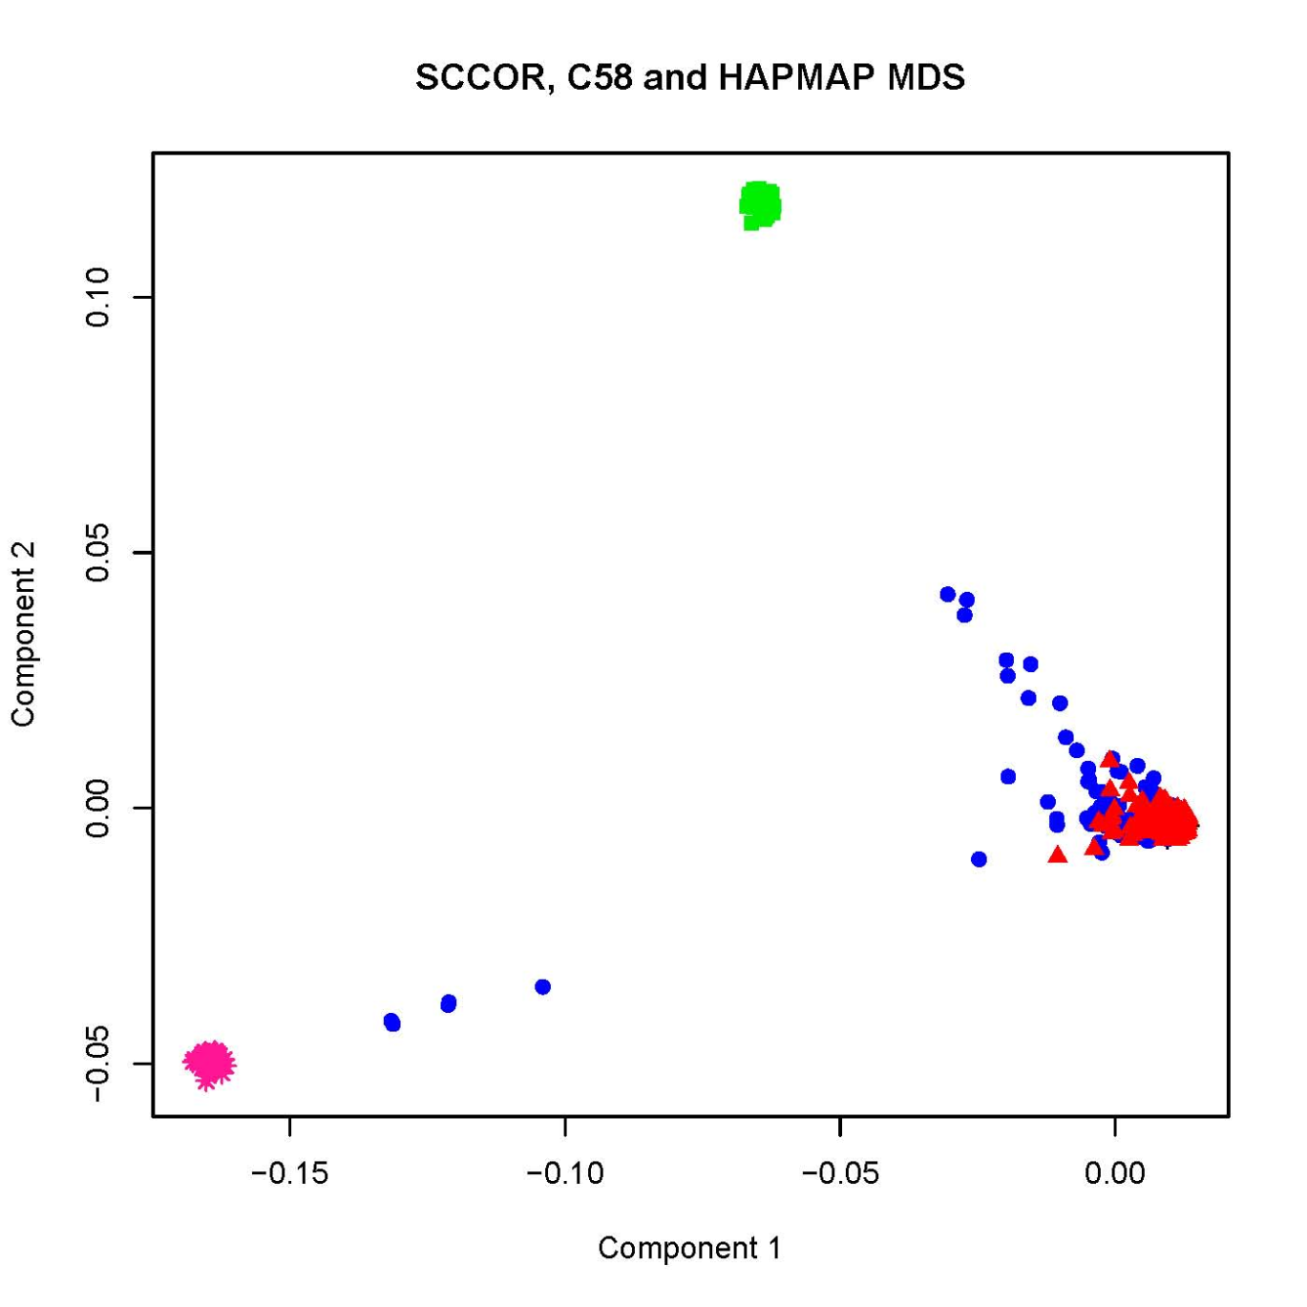
Detecting Outliers Using PCA
CHB/JPT
CEU
Cases
YRI
YRI
Wellcome Trust
1958 Birth Cohort
Controls
Notes:
28

Slide 29
Detecting Outliers
Information from Individuals from other ethnic groups can help to determine if outliers are potentially a member of another ethnic group
HapMap samples can be used for this purpose
When controlling for population substructure/admixture by including MDS or PCA components in the analysis
  Should not obtain components including the HapMap samples

Slide 30
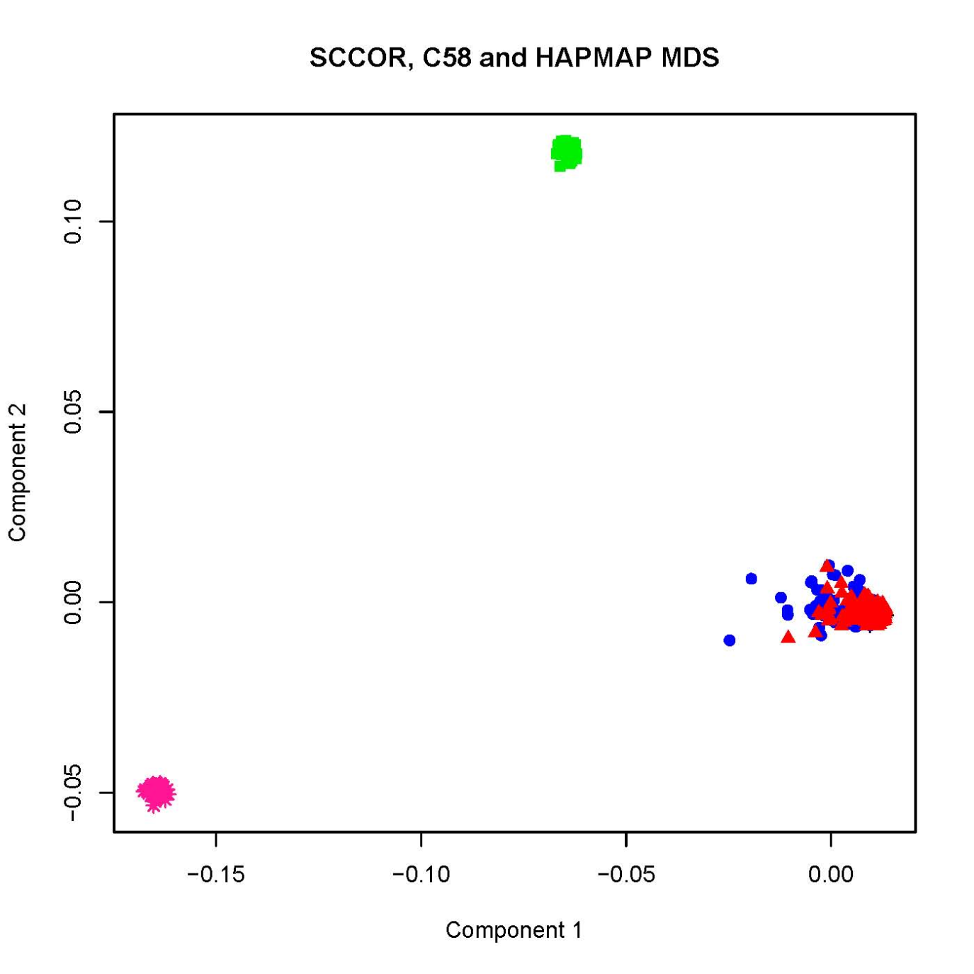
After removing outliers
CHB/JPT
CEU
Cases
Wellome Trust
1958 birth cohort
Controls
YRI
Notes:
30

Slide 31
Detecting Genotyping Error
Testing for Deviations from HWE not very powerful
The power to detect deviations from HWE is dependent on
  Error rates
  Underlying Error Model
    Random
    Heterozygous genotypes -> homozygous genotypes
    Homozygous genotypes ->Heterozygous genotype
  Minor Allele frequency

Slide 32
Detecting Genotyping Error
Controls and Cases are evaluated separately for deviations from HWE
  Deviation found only in cases can be due to an association
Quantitative Traits
  Caution should be used removing markers which deviate from HWE may be due to an association
    Only flag markers or
    Remove markers with extreme deviations from HWE and Flag markers with less extreme deviations from HWE

Slide 33
Detecting Genotyping Error
In the presents of genotyping error
  Random error and equal allele frequencies
  Power to detect deviation from HWE is α
Pseudo SNPs lend themselves to readily be detected through testing for deviation from HWE

Slide 34
Testing for Deviations in HWE
What α value should be used to reject the null hypothesis of HWE?
Multiple testing
For different studies a variety of α values are used
WTCCC used a p<5 X 10⁻⁷ for the exact test performed in the two control populations as the criterion to remove SNPs
Some studies use a genome wide significance p<5x10⁻⁸

Slide 35
Testing for Deviations from HWE
A large variety of criterion are used to reject the null hypothesis of HWE
However large p-value should be avoided
  e.g. p <0.005

Slide 36
Testing for Deviations from HWE
Deviations from HWE can be used to flag SNPs
  E.g. Remove those SNPs with deviations from HWE with p<10⁻⁷
    Note should be more conservative if using data for imputation
  SNPs can then be investigated in more detail later for reasons for the observation of deviation from HWE
    If there are significant association results

Slide 37
Deviation from HWE
HWD coefficient (Weir 1996)
For SNPs (2 allele system)
The proportion observed for N genotypes G₁₁, G₁₂ and G₂₂
  Is P₁₁, P₁₂ and P₁₂ respectively
p is the allele frequency which is estimated by
  (2*G₁₁ + G₂₂)/2N

Slide 38
Deviation from HWE
Under HWE D=0
Negative values of D indicate an excess of heterozygote genotypes
Positive values of D indicate an excess of homozygote genotypes
For a diallelic system
  D can range from -0.25 to 0.25

Slide 39
Detecting Genotyping Error
Markers not in HWE
  May be due to population admixture
    Excess of heterozygous genotypes (-D)
  Copy number repeats (CNVs)
    Either an excess of heterozygous (-D) or homozygous genotypes (+D)
Heterozygous Advantage
  Excess of heterozygous genotypes (-D)

Slide 40
Detecting Genotyping Error
Chance
  Either an excess of heterozygous (-D) or homozygous genotypes (+D)
Deviation from HWE due to genotyping error
  Either an excess of heterozygous (-D) or homozygous genotypes (+D)
Deviation from HWE due to pseudo SNPs
  Excess of heterozygous (-D) genotypes

Slide 41
Detecting Genotyping Error
Indication that deviation from HWE due to genotyping error
  Higher genotype drop out rates for specific markers
Pseudo SNPs
  Primers map to multiple genomic regions

Slide 42
Deviation from HWE in the Genotypes of Cases/Affected Proband at the Functional Locus
Deviation from HWE can be due to sampling
  Deviation increases with genotypic RR
Genotype data from cases deviate from HWE when the SNP which is being tested is functional or in LD with a functional variant
  Additive genetic model (D- excess heterozygous genotypes)
  Dominant genetic model (D- excess heterozygous genotypes)
  Recessive genetic model (D+ excess homozygous genotypes)
  Multiplicative genetic model there is no deviation from HWE (D=0.0)

Slide 43
Deviation from HWE in Genotype data for Cases/ Affected Probands at the Functional Locus
Odds Ratio
1.5
Genotypic RR 1.5

Slide 44
Deviation from HWE in Controls at the Functional Locus
Controls – unaffected individuals
  Display an extremely small deviation from HWE
  Deviation from HWE is higher with higher disease prevalence
Only unascertained samples have no deviation from HWE at the functional locus

Slide 45
QQ plot
QQ (quantile-quantile) plot is a graphical method for diagnosing differences between a random sample and a probability distribution
Assume there are n points, ordered as x₍₁₎<…<x_{(n)}. Then for i=1,…,n, we plot x_{(i)} against the i^{th} quantile (q_{i}) of the specified distribution (e.g., normal).
If the random sample is from the specified distribution, the QQ plot will be a straight line

Slide 46
How to Do It
Let F() be the cumulative distribution function of a random variable, e.g., F(z)=P(x<z).
The ordered n samples, x₍₁₎<…<x_{(n)}, are treated as n empirical quantiles and the i^{th} theoretical quantile, q_{i}, corresponding to x_{(i)} can be calculated as q_{i}=F⁻¹((i-0.5)/n)
Plot q_{i} on x axis and x_{(i)} on y axis

Slide 47
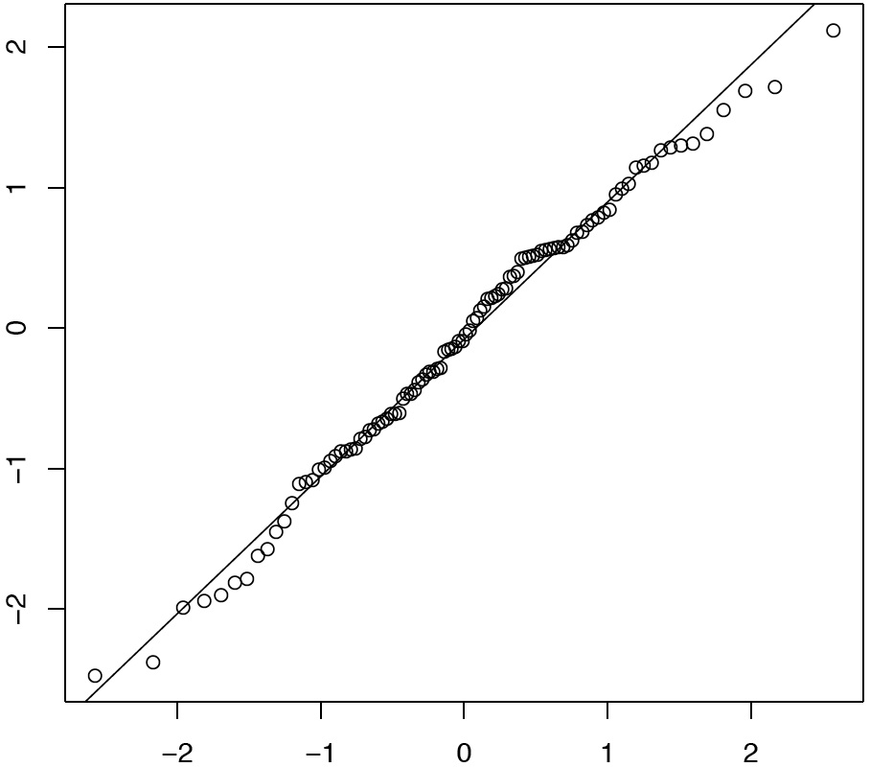
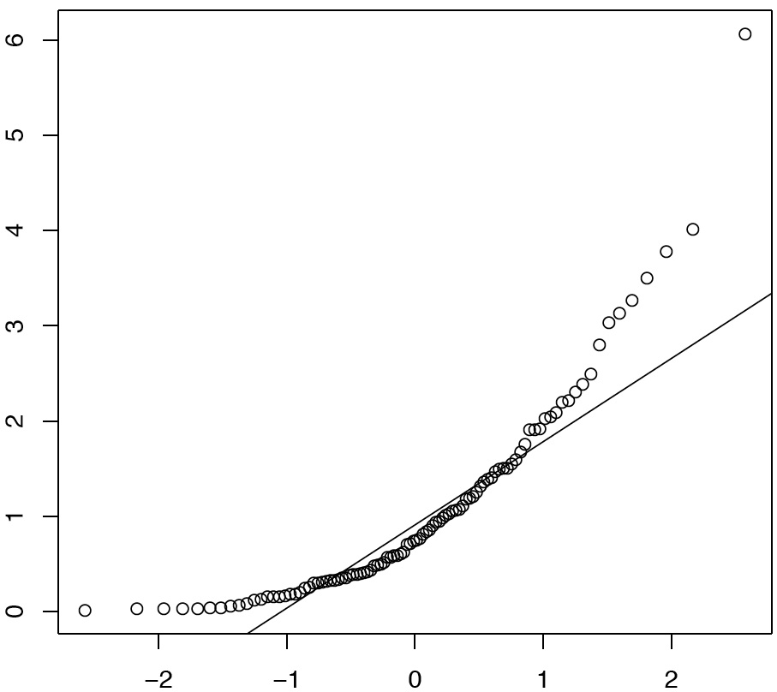
Examples
Normal-Normal QQ plot
Exponential-Normal QQ plot
100 Samples from Normal
100 Samples from Exponential
Normal Theoretical Quantiles
Normal Theoretical Quantiles

Slide 48
Genome Wide Association Diagnosis
Thousands of markers are tested simultaneously
The p values of neutral markers follow uniform distribution
If there are systematic biases, e.g., population substructure, genotyping errors, there will be significant deviation from uniform, especially for small p values
QQ plots offers a intuitive way to visually detect the system biases

Slide 49
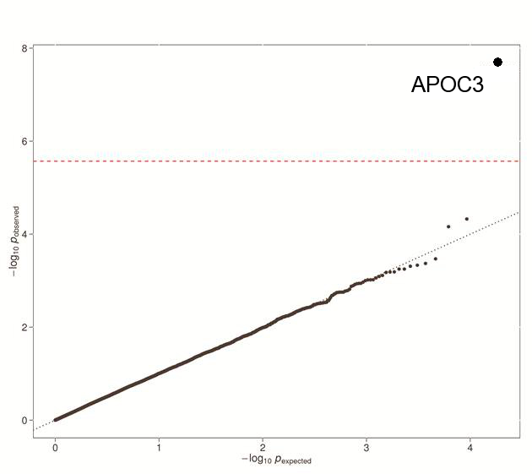
QQ Plot of Exome Wide P Values
All associations under the null except one

Slide 50
Genomic Inflation Factor to Evaluate Inflation of the Test Statistic
Genomic Inflation Factor (GIF): ratio of the median of the test statistics to expected median and is usually represented as λ
  No inflation of the test statistic λ=1
  Inflation λ>1
  Deflation λ<1
Can also examine the mean of the test statistic

Slide 51
Phenotype | Covariate | Mean Chi-Square | GIF (λ)
BP |  | 1.23829 | 1.16932
BP | Age | 1.24119 | 1.18025
BP | Age-EV1 | 1.09471 | 1
BP | Age-EV2 | 1.0881 | 1
BP | Age-EV4 | 1.08385 | 1
BP | Age-EV10 | 1.09582 | 1.00402
BPI |  | 1.14931 | 1.08921
BPI | Age | 1.15139 | 1.08113
BPI | Age-EV1 | 1.05079 | 1.01148
BPI | Age-EV2 | 1.0428 | 1
BPI | Age-EV4 | 1.04204 | 1
BPI | Age-EV10 | 1.05421 | 1.01724
BPII |  | 1.17283 | 1.25664
BPII | Age | 1.17583 | 1.26996
BPII | Age-EV1 | 1.09874 | 1.15065
BPII | Age-EV2 | 1.09904 | 1.16425
BPII | Age-EV4 | 1.09502 | 1.14609
BPII | Age-EV10 | 1.10046 | 1.1418
BPII | Sex,Age-EV1 | 1.05958 | 1.06424
BPII | Sex,Age-EV4 | 1.05817 | 1.05323
BPII | Sex,Age-EV10 | 1.06338 | 1.05581

Slide 52
Significance Results
For those SNPs with strong associations
Cluster plots should be examined
Poor clustering – overlap between clusters
  Could be the reason for the strong association
Cluster caller should be adjusted when possible and data reanalyzed

Slide 53
Order of Data Cleaning
Remove samples missing >3% genotype data
Remove SNPs with missing genotype data
  >5% missing genotypes
  If minor allele frequency <5%
    Remove markers with >1% missing genotypes

Slide 54
Order of Data Cleaning
Check for sex of individuals based on X-chromosome markers
  Remove individual whose reported sex is inconsistent with genetic data
    Could be due to a sample mix-up
Check for cryptic duplicates and related individuals
  Used “trimmed data set of markers which are not in LD
    E.g. r²<0.5
  Retain duplicate with best genotyping quality

Slide 55
Order of Data Cleaning
Perform principal components analysis to check for outliers
  Use trimmed data set of markers which are not in LD
    E.g. r²<0.5
  Remove outliers from data

Slide 56
Order of Data Cleaning
Check for deviations from Hardy Weinberg Equilibrium
  Separately in cases and controls
  If more than one ethnic group
    Separately for each ethnic group

Slide 57
Order of Data Cleaning
Examine QQ plots for potential problems with the data
  e.g. not controlling adequately for population admixture

